Slide 1

Smart Cities Architecture and Implementation Workshop: Standards and Technology
Facilitators
Kary Främling
Adjunct Professor
Aalto University,
Finland
Avleen Malhi
Postdoctoral Researcher
Aalto University,
Finland
Tuomas Kinnunen
Research Assistant
Aalto University,
Finland
Asad Javed
PhD Researcher
Aalto University,
Finland
Email: firstname.lastname@aalto.fi

Slide 2
Agenda
Introduction
Open Messaging Standards (O-MI and O-DF)
O-MI/O-DF Reference Implementation
How to run O-MI node
Live demos
(Scripts and Slides are available at: https://github.com/AaltoAsia/Dublin-workshop)

Slide 3
Introduction
This workshop will address the practical aspects of using IoT technology to deliver smart city solutions.
Goal of the Workshop:
Install O-MI Node reference implementation
Use an IoT device to send sensor values to your Node
Make a data subscription to send value from your Node to our Node
We will have live visualization of all the data coming to our O-MI Node

Slide 4
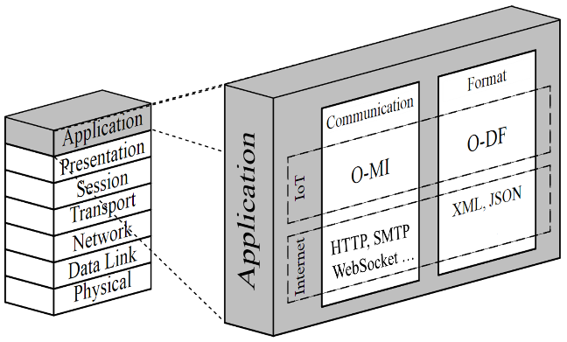
Open Messaging Standards
Defined by The Open Group as Open Messaging Interface (O-MI) and Open Data Format (O-DF)
Provide peer-to-peer communication and real-time interaction between devices or information systems
Capabilities: IoT CRUD (Create, Read, Update, Delete)
O-MI: Provides a framework to publish and consume real-time information
O-DF: Represents a data payload

Slide 5
Open Data Format (O-DF)
Defined as a simple ontology and specified using XML Schema
Provides structure and mechanism to annotate data for information exchange
Generic enough for representing “any” object and information

Slide 6
Open Message Interface (O-MI)
Enables communication between heterogeneous devices and information systems
O-MI node can act both as a “server” and as a “client”
O-MI Properties:
Self-contained messages
Protocol-agnostic messages
Different payload formats
Specifying time-to-live
Publication and discovery of new services and metadata
Subscription of data or services
Often used on top of HTTP or Websockets

Slide 7
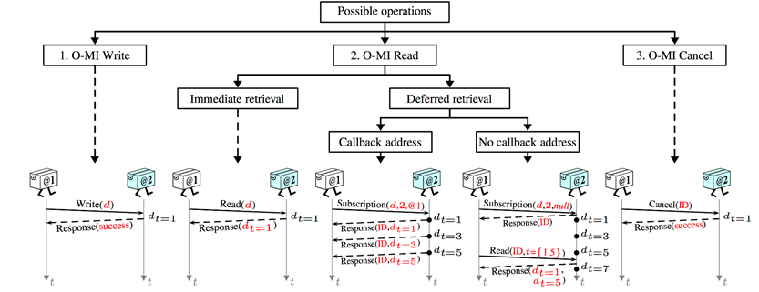
O-MI Basic Operations
Write information, such as sensor values, setpoints, alerts, etc
Read current and historical information, alerts, other events
Subscribe to information with or without callback
Cancel subscriptions before expiration

Slide 8
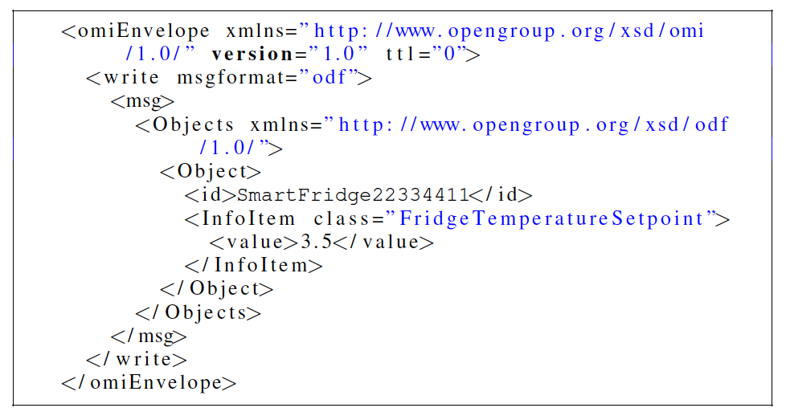
An example Write message

Slide 9
O-MI/O-DF Reference Implementation
Open source implementation developed at Aalto University
Available at: https://github.com/AaltoAsia/O-MI
Enable fast deployment of IoT node

Slide 10
O-MI Node Server
Main building block of reference implementation
Supports all O-MI operations, handles user requests, and manages the database
Agent management system
Mechanism to interact programmatically with the core of an O-MI node
Can filter and modify incoming O-MI requests
Can push and pull sensor data to and from database

Slide 11
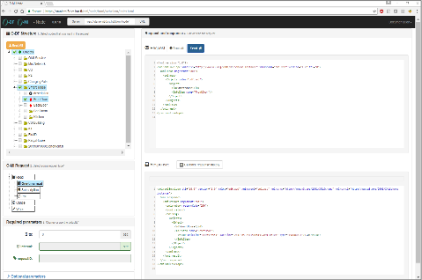
Web Client
Graphical user interface for the developers to create and test O-MI messages
Sandbox for testing O-MI operations or features

Slide 12
Wrapper
A piece of code that converts to or from O-MI/O-DF is considered as a “wrapper”
Combine data from different source or system with different/same protocol into single O-DF structure for publishing
Encapsulate underlying lower protocol for data consumer
e.g. 1-Wire, third party system, KNX etc.
Wrapper can be written in any programming or scripting language.
e.g.: Shell script, Java, Python, C etc.

Slide 13
How to run O-MI node?
Dependency Java JDK 1.8
https://www.oracle.com/technetwork/java/javase/downloads/jdk8-downloads-2133151.html
Run pre-compiled node:
Download the latest release version and unpack it. Available at: https://github.com/AaltoAsia/O-MI/releases
For Windows: Use “o-mi-node-1.0.9.zip” (Don’t use deep directory structure)
For MAC/Linux: Use “o-mi-node-1.0.9.tgz”
To allow write requests from other machines you need to modify file “<Extracted folder>/conf/application.conf”.
Change the setting “allowRequestTypesForAll”, add “write” to the list, such that the result looks like this:
allowRequestTypesForAll = ["read", "cancel", "call", "write"]
For Windows: Go to the <Extracted folder>/bin and click on o-mi-node.bat For MAC/Linux: cd <Extracted folder>/bin and add execute instructions “chmod +x o-mi-node” and then run “./o-mi-node”
The server can now be accessed with URL http://localhost:8080/ and open OMI test client on this URL

Slide 14
Open Firewall port for O-MI in Windows
Navigate to Control Panel -> System and Security -> Windows Firewall
Select ‘Advanced settings’ from the left menu and highlight Inbound Rules in the left pane
Right click Inbound Rules and select New Rule
Select ‘Port’ and click Next
Add the port you need to open and click Next
Select TCP protocol and add ’8080’ in the port field and click Next
Select Allow the connection in the next window and hit Next
Select the network type and click Next
Name the rule something meaningful and click Finish

Slide 15
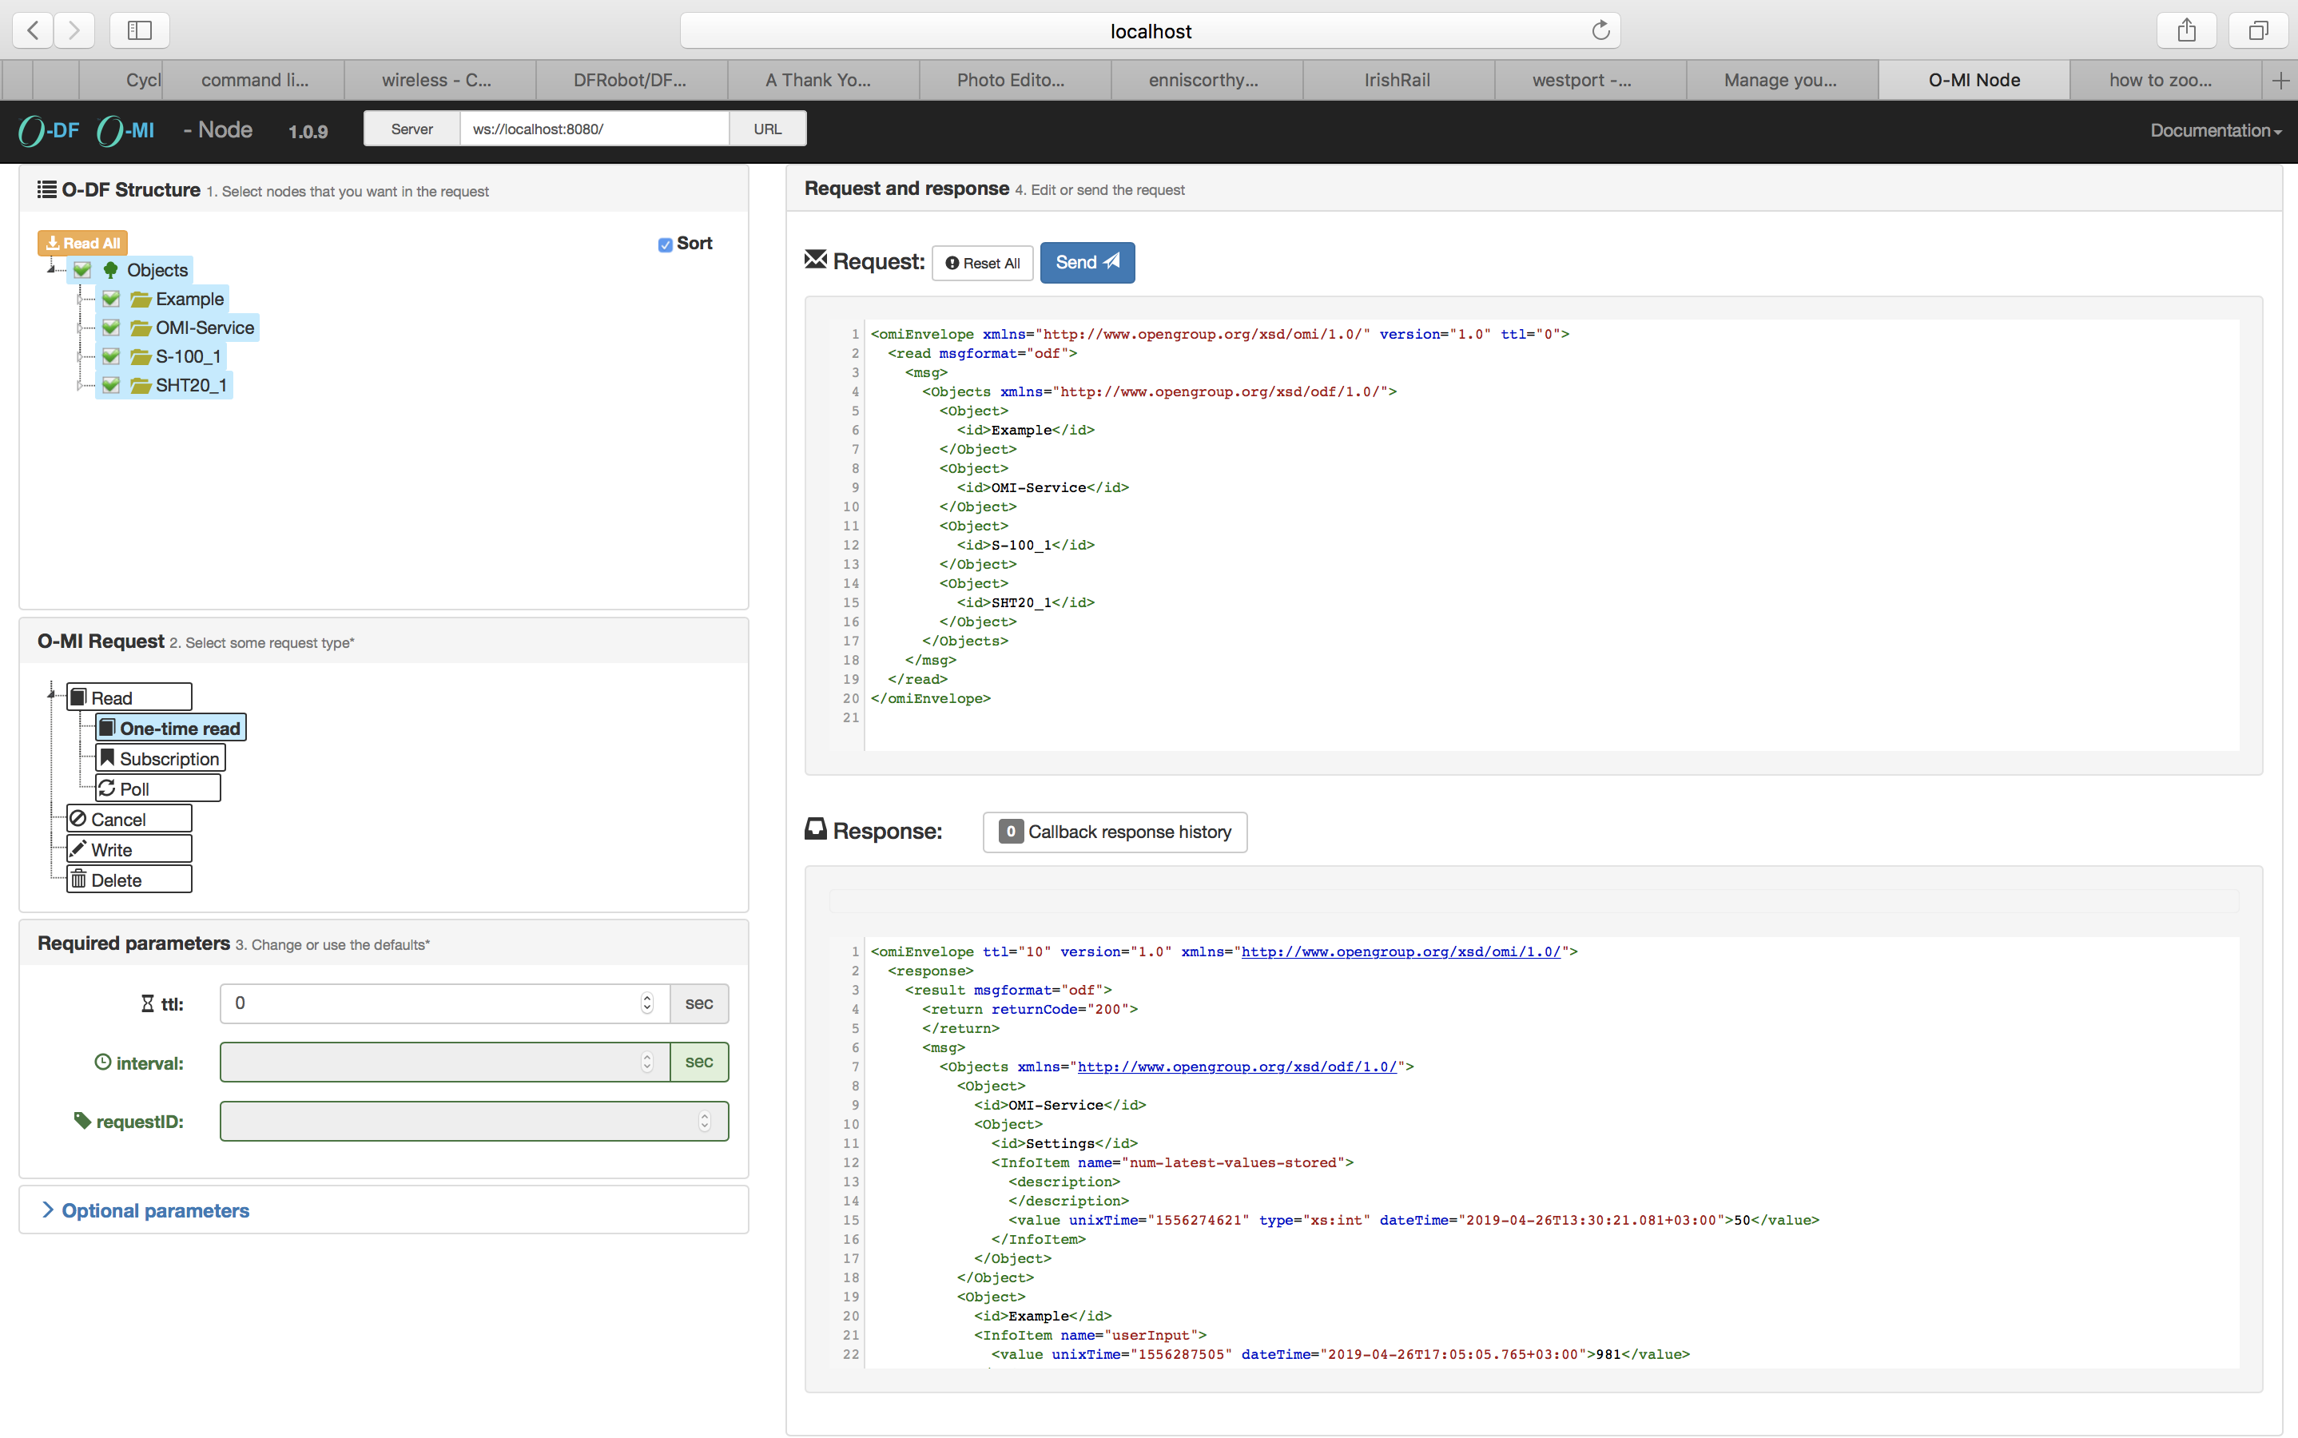
O-MI/O-DF Sandbox
Object of Interest
O-MI Request
O-MI Operation
O-MI Parameters
O-MI Response

Slide 16
Steps to publish data with reference implementation
Step 1: Deploy reference implementation
Step 2: Develop wrapper for getting and publishing data
Step 3: Send O-MI write request to create or update data periodically using wrapper
Step 4: Use Web Client to test other O-MI/O-DF functionality such as one time read, subscription, delete etc.
Note: Other system can also read/subscribe published data by sending read/subscription request.

Slide 17
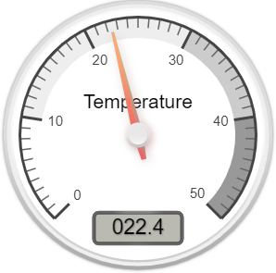

Case Study: Smart Home
O-MI/O-DF Node Server
O-MI
Write
Request
O-MI
Subscription
Agent Manager 1
Wrapper
Agent 1
Agent 2
Monitoring Unit
O-MI
Response
O-MI/O-DF Web Client
Data Publisher
O-MI/O-DF Reference
Implementation
Data Analytics

Slide 18
Smart Home Scenario Description
Smart Home equipped with
Temperature and Humidity sensor (SHT-20 and 1-wire)
CO2 sensor (S-100)
Wrapper to publish smart home data to O-MI node
Read sensor value
Translate it to O-DF
Put it in O-MI Write request
Send with HTTP POST request
Developer can test the system using web-client
Data consumer (Monitoring unit) might be interested in these sensor values for analyzing the required object values. It can subscribe to the objects of interest

Slide 19
Hardware and Sensors Provided
Raspberry Pi boards (Model 1 and 3)
ESP8266 WiFi development modules
SHT20 Temperature and humidity sensor
S-100 CO2 sensor
1-Wire temperature and humidity sensor

Slide 20
Live Demo
Implementation Using Raspberry Pi (RPi)

Slide 21
1-Wire Sensor Installation
sudo raspi-config -> Interfacing options
enable 1-wire
enable i2c protocol
Add ”i2c-bcm2708” and ”i2c-dev” modules (on separate lines) in /etc/modules
sudo nano /etc/modules
sudo reboot
Verify that i2c bus is enabled
sudo i2cdetect –y 1
You should get a table as result

Slide 22
OWFS Installation
Firstly install some neccesary and useful packages
sudo apt-get update
sudo apt-get install automake autoconf autotools-dev gcc-4.7 libavahi-client-dev libtool libusb-dev libusb-1.0-0-dev libfuse-dev swig python2.7-dev i2c-tools
Download the latest version of OWFS
cd /usr/src
sudo wget -O owfs-latest.tgz http://sourceforge.net/projects/owfs/files/latest/download
Unpack OWFS
sudo tar xzvf owfs-3.0p0.tgz
Go to the directory and configure OWFS
sudo ./configure

Slide 23
OWFS Installation
Compile OWFS
sudo make (sudo make -j 4, if RPi-3)
sudo make install
Create mountpoint for 1-wire
sudo mkdir /mnt/1wire
To access the 1-wire without root privileges:
sudo nano /etc/fuse.conf
Change #user_allow_other to user_allow_other

Slide 24
Connecting to Raspberry Pi with SSH
Connect to our WiFi “TP-LINK_C5E618”
For Windows:
Use putty (https://www.putty.org/)
For MAC: Open terminal
Connect to RPi:
ssh pi@ipAddress
ssh (to RPi-3)
User: pi
Password: Qwerty123
ssh (to RPi-1)
User: pi
Password: raspberry
Download the provided scripts from https://github.com/AaltoAsia/Dublin-workshop
RPi ID | IP address
R1 | 192.168.1.10
R2 | 192.168.1.11
R3 | 192.168.1.12
R4 | 192.168.1.13
R5 | 192.168.1.14
M1 | 192.168.1.15
W1 | 192.168.1.17
W2 | 192.168.1.16

Slide 25
Start 1-wire (Start from here with RPi)
Start OWFS
sudo /opt/owfs/bin/owfs -u /dev/ttyUSB0 --allow_other /mnt/1wire/
Check the contents of 1-wire
ls /mnt/1wire/
(You will find the directory starting with 26. which contains the sensors data (or 2 directories with 26. if using two 1-wire sensors in chain))
Read the sensor values from the directory starting with ”26.”
cat /mnt/1wire/<26…>/temperature
cat /mnt/1wire/<26…>/humidity
Download the scripts on Raspberry Pi and go to the cloned directory:
git clone https://github.com/AaltoAsia/Dublin-workshop.git
cd Dublin-workshop

Slide 26
Start 1-wire
‘omi-write.sh’ and ‘create-odf.sh’ scripts on GitHub is used to send 1-wire data to O-MI node
In the “create-odf.sh” script:
Type “nano create-odf.sh” to edit this script file
Update the Object id to some unique name. Change the name ‘OneWireSensor’ (appeared in two places) to your own defined name.
Update the 1-wire sensor id in the following line:
Place sensor id here starting with 26.

Slide 27
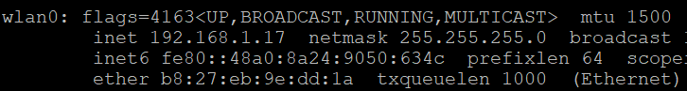
Start 1-wire
Find the IP address of your laptop (where you run O-MI node):
For Mac/Linux: Run “ifconfig” in the terminal and note the IP address of wlan0 interface:
For Windows: Run “ipconfig” in the command prompt.
In the “omi-write.sh” script:
Change the address of O-MI node to http://yourIP:8080 in the following line at the end of script:
“curl_cmd=$(curl --data "$(omiWrite)" "http://myhost:port")”
Finally, run the script
./omi-write.sh

Slide 28
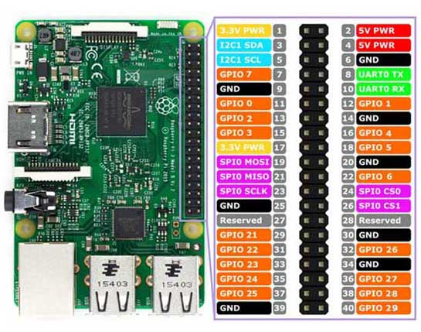
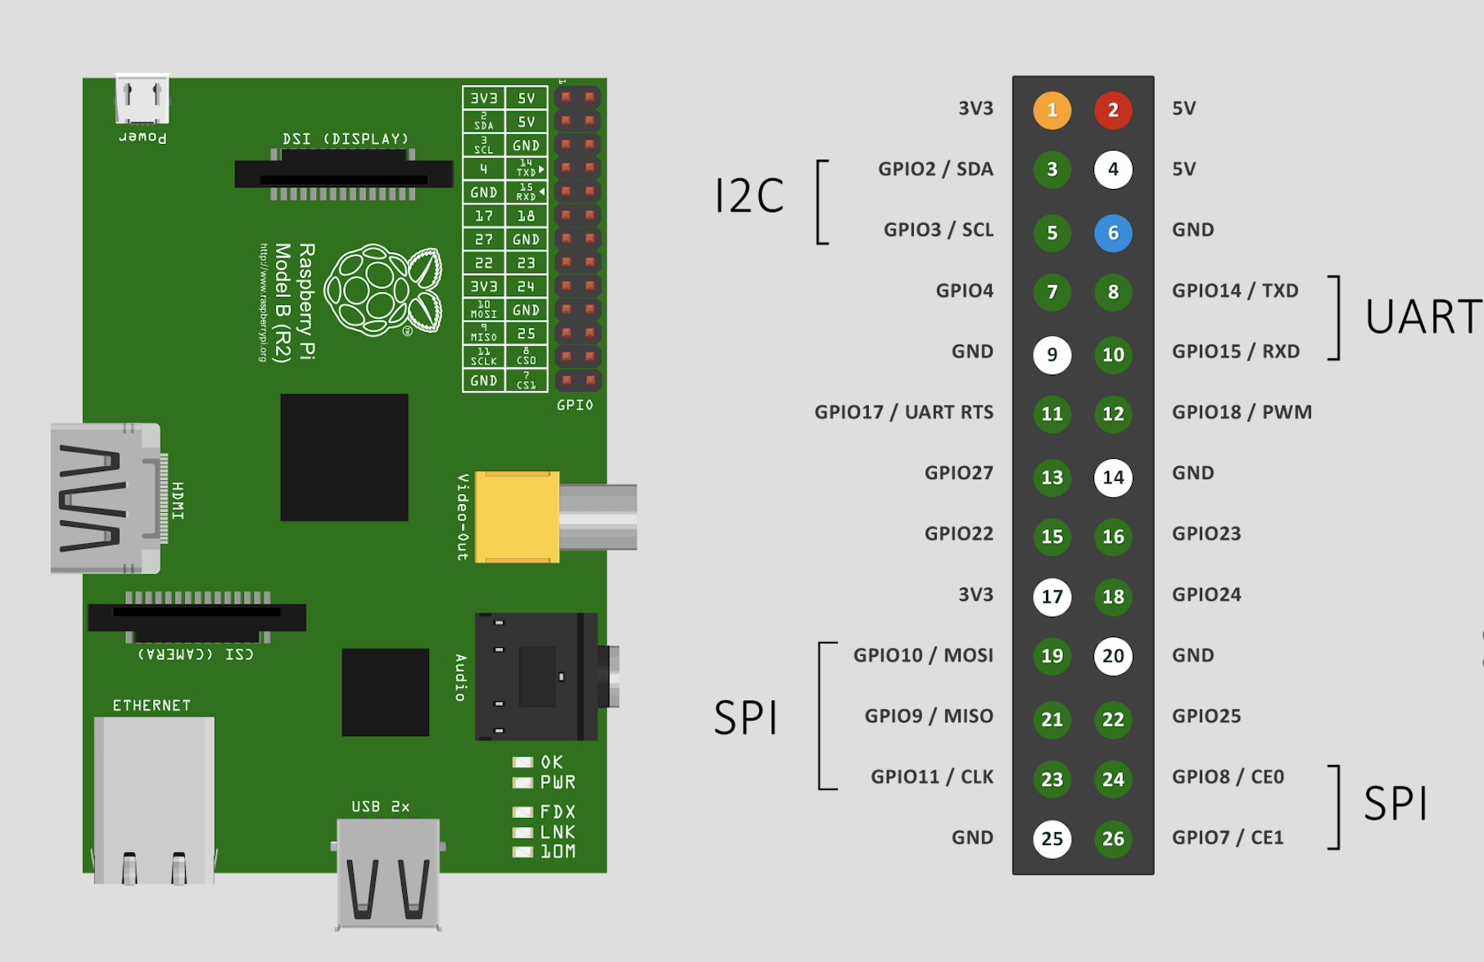
Raspberry Pi Pinout
Raspberry Pi 1
Raspberry Pi 3

Slide 29
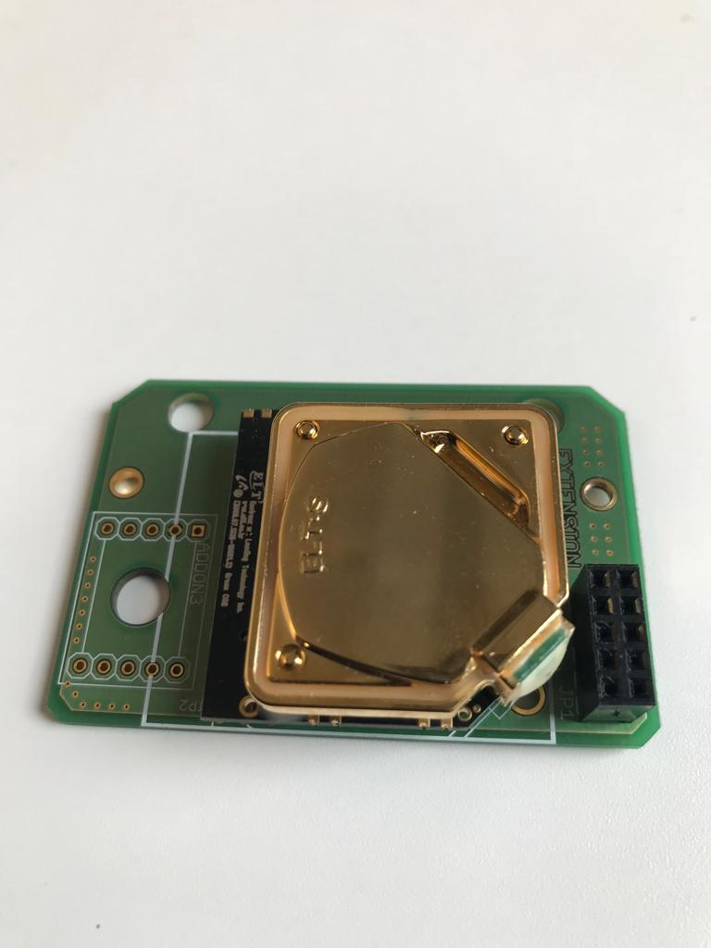
CO₂ Sensor (Model: S-100)
TX
GND
5V
Connect jumper cables:
Sensor TX -> RPi RX
Sensor GND -> RPi GND
Sensor 5V -> RPi 5V
Run ‘./co2-omi-send.py’ script

Slide 30
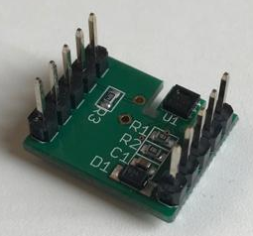
Temperature and Humidity Sensor (Model: SHT-20)
# ? * ?
+ GND * ?
*? * 3v3
*? * SDC
*? * SDA
GND
SDA
SDC
3.3V

Slide 31
Temperature and Humidity Sensor (Model: SHT-20)
Install the sensor python library
sudo apt-get update
sudo pip3 install sensor
Connect the jumper cables:
Sensor SDC -> RPi SDC
Sensor SDA -> RPi SDA
Sensor GND -> RPi GND
Sensor 3V -> RPi 3V
Read the temperature and humidity value (run the provided python script ’./ht-omi-send.py’ or ’python3 ht-omi-send.py’)
Important steps:
Do change the address of O-MI node (http://yourIP:8080)
Also, please change the Object id to some unique name in the O-MI XML structure

Slide 32
Live Demo
Implementation Using ESP8266

Slide 33
ESP8266 Arduino Configuration
The ESP8266 is a very low-cost Wi-Fi microchip with full TCP/IP stack and microcontroller capability.
Arduino is an open-source electronics platform based on easy-to-use hardware and software.
Install latest Arduino IDE from https://www.arduino.cc/en/main/software
Start Arduino and open Preferences window.
Enter https://arduino.esp8266.com/stable/package_esp8266com_index.json into Additional Board Manager URLs field.
Open Boards Manager from Tools > Board menu and install esp8266 platform
For MAC machine, download and install the driver ”CH34x_Install_V1.5.pkg” from https://github.com/adrianmihalko/ch340g-ch34g-ch34x-mac-os-x-driver
Restart the Arduino IDE

Slide 34
CO₂ Sensor (Model: S-100)
TX
GND
5V
Connect jumper cables:
Sensor TX -> ESP RX
Sensor GND -> ESP GND
Sensor 5V -> ESP 5V

Slide 35

Interfacing CO₂ Sensor with ESP8266
Connect ESP chip with your laptop USB port.
Start Arduino IDE and select the following board from Tools -> Board
LOLIN (WEMOS) D1 R2 and Mini
Select port using Tools -> Port
Open /SoS-Scripts/CO2_test (test scripts for CO2 sensor)
Open create_odf tab in Arduino and change <id> of the Object to something unique and change the url to your O-MI Node (http://yourIP:8080/)
Note: Disconnect the RX of ESP8266 while uploading the code.
Press Upload button
Connect RX of ESP8266 again after uploading is done.
If it fails you might have wrong port or too high upload speed
View the output through Tools -> Serial Monitor
Select baud rate as 38400

Slide 36
Temperature and Humidity Sensor (Model: SHT-20)
# ? * ?
+ GND * ?
*? * 3v3
*? * SDC
*? * SDA
GND
SDA
SDC
3.3V
Connect jumper cables:
Sensor SDA -> ESP SDA (D2)
Sensor SDC -> ESP SDL (D1)
Sensor GND -> ESP GND
Sensor 3.3V -> ESP 3V3

Slide 37
SHT20 Sensor
Download the library for SHT20 from https://github.com/DFRobot/DFRobot_SHT20 into the ’libraries’ folder of your Arduino installation directory (<....>/Documents/Arduino/libraries).
Open /SoS-Scripts/temp_humi_test (test scripts for SHT20 sensor)
Open create_odf tab in Arduino and change <id> of the Object to something unique and change the url to your O-MI Node (http://yourIP:8080/)
Press Upload button
Tools -> Serial Monitor
Select baud rate as 115200

Slide 38
CPU Temperature (For Linux machine)
Install some required packages
sudo apt-get update
sudo apt-get install lm-sensors
sudo sensors-detect
Start the service
sudo service kmod start
Read the temperature and send the value to O-MI node using the provided script.
while true; do sensors -u | awk '/temp1_input/ {print $2}' | ./omi-send-linux.py; sleep 2s; done

Slide 39
CPU Temperature (For MAC machine)
Download latest version of python: (if not already installed) https://www.python.org/downloads/release/python-373/
Download pip for python3 and other required packages:
curl https://bootstrap.pypa.io/get-pip.py -o get-pip.py
python3 get-pip.py
pip3 install requests
Reading CPU Temperature
Download source code from https://github.com/lavoiesl/osx-cpu-temp
Unzip the downloaded folder and ’cd’ to that directory
Run make
Copy omi-send-mac.py to the same directory
while true; do ./osx-cpu-temp | ./omi-send-mac.py; sleep 2s; done

Slide 40
Create a subscription for our visualization Node
Go to http://localhost:8080/ and go to ”O-MI Test Client WebApp”
Check that your data have been received correctly with a Read request, after that, continue with subscription:
Select ”Objects” from the O-DF tree
Select ”Subscription” request
Open ”Optional parameters”
Put address of the visualization node (http://192.168.1.20:8080/) to ”callback” field
Press ”Send” and see if your value shows on the visualization (after it changes next time)

Slide 41

Questions

Slide 42
Extra slides

Slide 43
Interoperability
Interoperability Challenge
Communication Interoperability
Infrastructure and mechanism
Technology Level
e.g. TCP/IP
Interface Level
Means of communication
e.g. O-MI, HTTP
Data Level Interoperability
Syntactic Level
Common Data Format
e.g. O-DF, CSV
Semantic Level
Shared Meaning
e.g. Mobivoc

Slide 44
Raspberry Pi setup
Operating System Installation:
Download and unzip Soft-float Debian “Wheezy" Operating System for Raspberry pi from http://www.raspberrypi.org/downloads
For flashing the Wheezy Operating System in SD card of the Raspberry Pi download and unzip Win32DiskImager.exe from http://sourceforge.net/projects/win32diskimager/
Run Win32DiskImager.exe , select the .img file unzipped from step 1, select the SD card and click Write.
Eject SD card safely from writer and insert it into raspberry.
Insert SD card in raspberry PI and connect the necessary IO devices (mouse, Keyboard and monitor) and Internet cable. start it by supplying the power.

Slide 45
Java Installation
Login into raspberry pi using default credential (username=pi and password= raspberry)
sudo apt-get update
sudo apt-get install openjdk-7-jdk

Slide 46
Writing data to O-MI Node
Add the sensor objects while creating data format
Add the IP address of the receiver O-MI node in write message
(The scripts have been created for your reference)
Object="OneWireSensor"
OneWireSensor_Object="Sensor1"
Sensor1_InfoItems="Temperature Humidity"
Sensor1_values="`eval "cat /mnt/1wire/26.0F85CB010000/temperature"` `eval "cat /mnt/1wire/26.0F85CB010000/humidity"`"
# Send write message
#curl_cmd=$(curl --data "$(omiWrite)" "http://192.168.1.100:8080")

Slide 47
CO₂ Sensor (Model: S-100)
Getting the value of sensor (baud speed is 38400)
Add the IP address of the receiver O-MI Node in OMI Node write script
(The script for sending the data has already been created for your reference)
Sending the value to O-MI Node
miniterm.py /dev/serial0 38400
Raspberry Pi 1
miniterm.py /dev/ttyS0 38400
Raspberry Pi 3
requests.post("http://192.168.1.103:8080"
miniterm.py /dev/serial0 38400 | ./omi-sent.py
Raspberry Pi 1
miniterm.py /dev/ttyS0 38400 | ./omi-sent.py
Raspberry Pi 3

